Slide 1


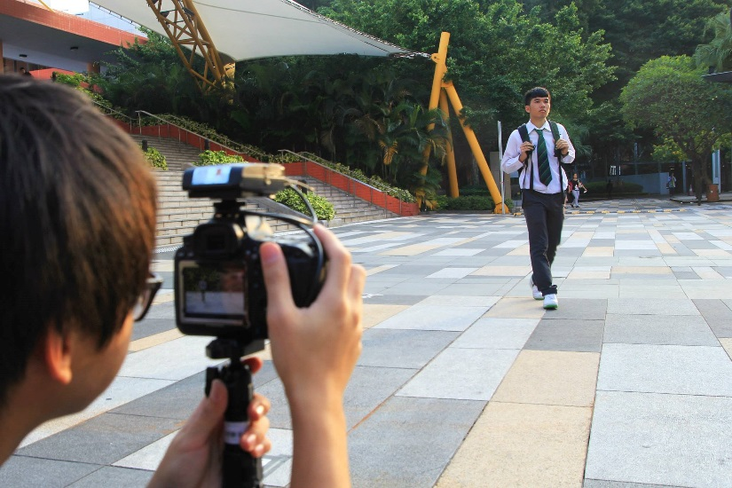
Case Study- One Letter Horse
一字馬
A project about “Digital Commons”

Slide 2
Content
Introduction of One Letter Horse
Talking about commons
Reasons to choose “One letter horse”
Literature reviews
Interviews
Findings/Implications
Future of Digital commons in Hong Kong
References

Slide 3
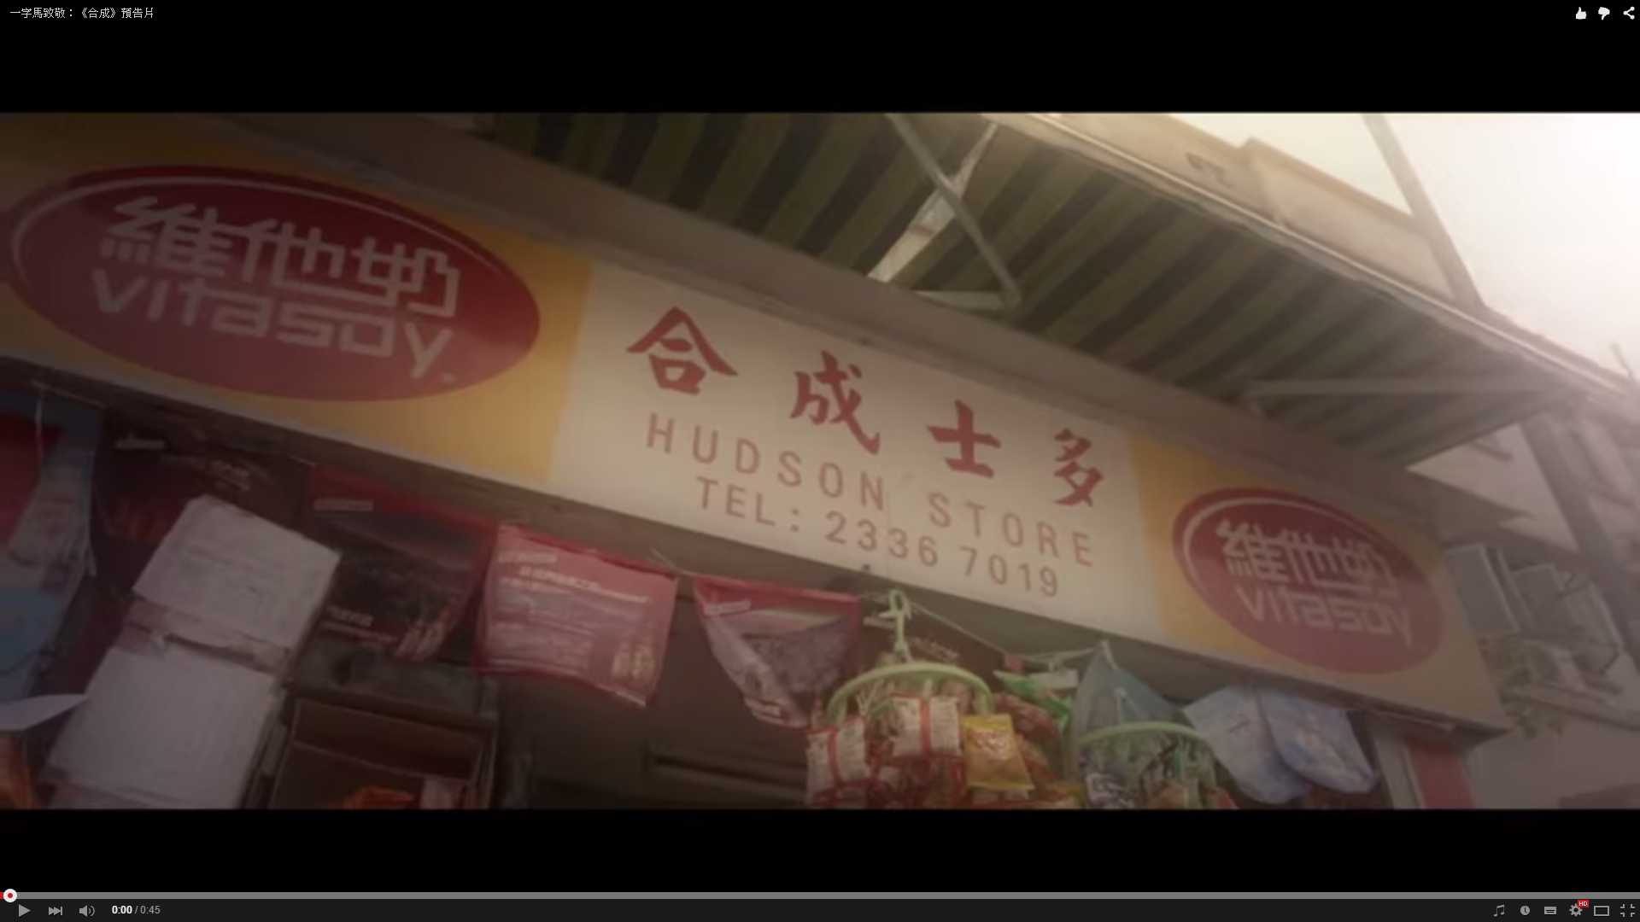
一字馬致敬：《合成》預告片
https://www.youtube.com/watch?v=tb6RW3Vd1GQ

Slide 4
1.What is One Letter Horse?
A group of 4 boys from CUHK
Active after Umbrella Movement
Regular production of political videos
YouTube/Facebook as the platform
A spirit of perseverance, humor and earnest

Slide 5
2.Commons
New idea in Hong Kong
Digital commons, cultural commons, knowledge commons
Digital commons are created, owned and shared between or among a community
non-exclusivedible, be available to third parties
they are oriented to favor use and reuse, rather than to exchange as a commodity

Slide 6
3.Why do I choose this as my case study?
Digital Commons → One letter horse (hot in CUHK)
No commercial concerns and enjoys high degree of freedom
Open access to all people
Shared, created, owned by every one
Curious on their views towards commons, sharing economies, “take back the economy”

Slide 7
4.Literature Review
The digital commons comprises informational resources created and shared within voluntary communities of varying size and interests. These resources are typically held de facto as communal, rather than private or public property.
(Felix, 2010)
The tragedy of the commons refers to an alleged tendency of freely available resources to degrade over time.
(Felix,2005)
Too many disparate licenses may make it harder for people to share content in an easy, interoperable way. It is not the proliferation of licenses is problematic, it is the absence of a mechanism to enable differently licensed works to “play together” so that they can commingle and be used to produce new things.
(Bollier,2008)

Slide 8
5.Interview with Angus
2/4/2015 12:30pm Interview with Angus
https://www.youtube.com/watch?v=QhlHiN6n1Bw&feature=youtu.be

Slide 9
6.Commons Identi-Kit: One Letter Horse
Access | Use | Benefit | Care | Responsibility | Property
Shared and wide | Negotiated | Widely distributed to community members | Performed by members | Assumed by community members | Any form of ownership (private, state or open access)
Everyone can get access, except those who don’t get used to Facebook, YouTube | Not for those who are not familiar with the productions. | Benefit to both audience and 4 members, esp. teenagers in same generations. | 4 boys are very serious to their production, they always argue on the plots, stories. | One of the member helps to due with all the coordinative work. They enjoys division of labour. | Open access, once you have electronic devices, you can access to.

Slide 10
6.Implications (in different scales)
One Letter Horse seeks their production as a commons but their work is restrained by the platform (YouTube)
Creative media industry are welcomed to the idea of digital commons, but with good management (cannot infringe others’ creative work)
Digital commons in Hong Kong are difficult to develop in long term, because of the radical change of the society and technology.
→ difficult to keep sharing or creating

Slide 11
7.Future of digital commons
Tragedy of commons: Free Software is threatened by a commercial move towards ‘software as service’
Difficult to self-organized
Cannot last a very long time (radical change)
Wiki is the best example to illustrate; others may not actualize the characteristics of “commons”
Take-back theme: respect to property that matter in the marking and sharing of commons, they need to be maintained and managed (p.147)

Slide 12
8.Reference
David Bollier (2008). Viral Spiral-How the Commoners Built a. London: The New Press. 204.
Felix Stalder (2005). Open Culture and the Nature of Network. Serbia: Futura publikacjie.
Lincoln Dahlberg. (2001). Exploring the prospects of online deliberative forums extending the public sphere. Information,Communication & Society. 4 (4), 615-633.
Graham Murdock. (2004). Building the digital commons: Public broadcasting in the age of the internet. The 2004 Spry Memorial Lecture.

